Slide 1
BoiBikreta
Online Book-Selling Database Management System

Slide 2
Entity and Attributes
Book (Book id, Book name, Edition, Publisher id, Price, Availability)
Author (Author id, Author name)
Genre (Genre id, Genre name)
Publisher (Publisher id, Publisher name)
Store (Store id, Store name, Address)
Employee (Employee id, Employee name, Job id, Salary, Address)
Job (Job id, Job name)

Slide 3
Entity and Attributes
Customer (Customer id, Customer name, Address)
Order (Order id, Customer id, Employee id, Order date, Ship date, Total price)
Offer (Offer id, Offer name, Start date, End date)
Supplier (Supplier id, Supplier name, Address)
Supply (Supply id, Supplier id, Store id, Order date, Ship date, Total price)

Slide 4
Entity Relationship Diagram
Described using Chen Model

Slide 5
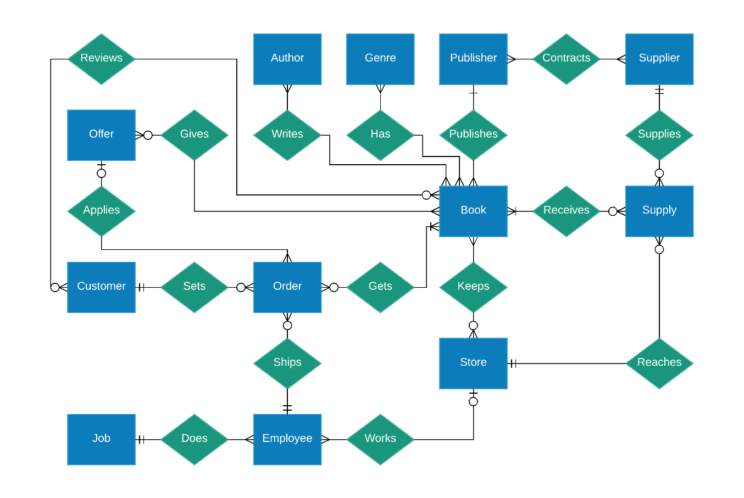

Slide 6
Schema
Described using Crow’s Foot Model

Slide 7
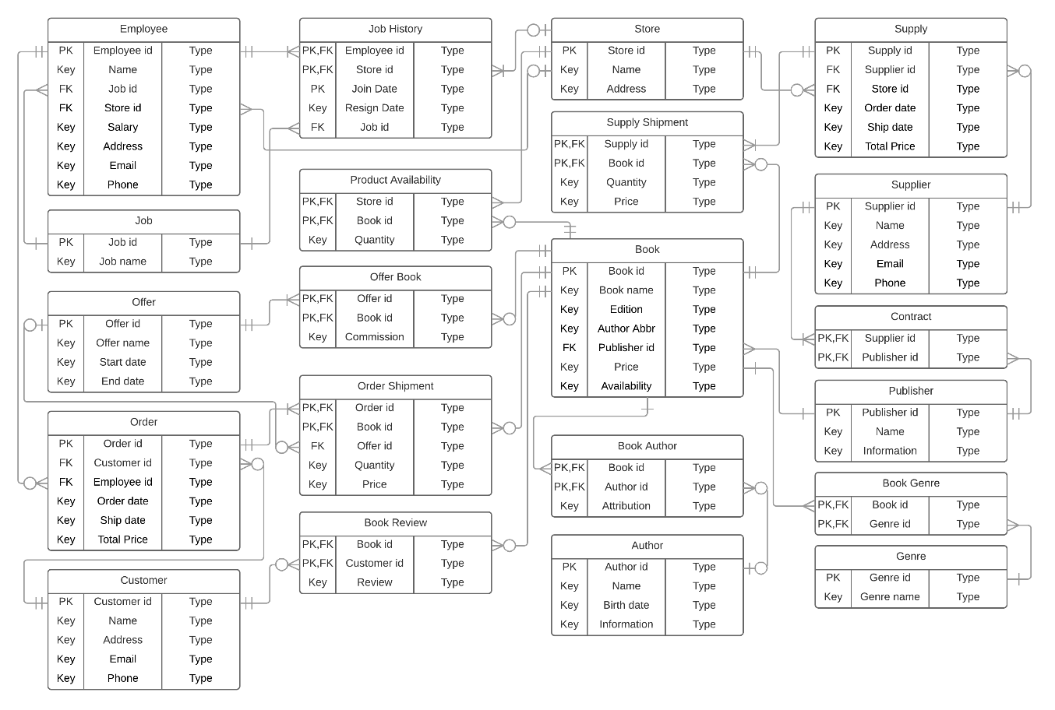

Slide 8
Thank You
Prepared By
Name: Tanveer Muttaqueen
Student id: 1505002
&
Name: Mohammad Tawhidul Hasan Bhuiyan
Student id: 1505008

